Slide 1
Intelligent Buildings Council (IBC)
Chair: Debra Becker (Honeywell)
Vice-Chair: Trevor Nightingale (National Research Council)
Vice-Chair: Robert Lane (Robert H. Lane and Associates Inc.)
Vice-Chair: Bob Allan (The Siemon Company)

Slide 2


Agenda Greg Walker (CABA)
1. Agenda
2. Call to Order, Welcome, Introductions
3. Administrative
4. “The role of Integrators in Intelligent Buildings” (30 min)
5. Research Update
6. White Paper Sub-Committee Update
7. New Business
8. Announcements
9. Adjournment

Slide 3
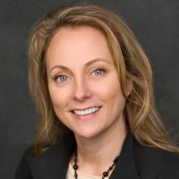
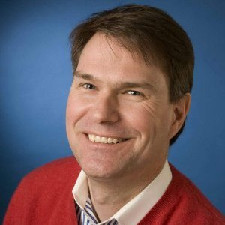
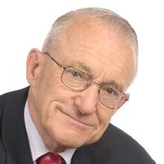
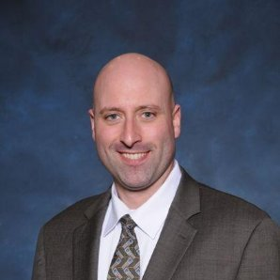




Call to Order, Welcome, Introductions – About the IBC Debra Becker (Honeywell)
IBC Chair
Debra Becker
Connected Buildings Leader
Honeywell
IBC Vice-Chair
Trevor Nightingale
Director
National Research Council
IBC Vice-Chair
Robert Lane
President & Managing Partner
Robert H. Lane and Associates Inc.
IBC Vice-Chair
Bob Allan
Product Marketing Manager
The Siemon Company
The CABA Intelligent Buildings Council works to strengthen the large building automation industry through innovative technology-driven research projects. The Council was established in 2001 by CABA to specifically review opportunities, take strategic action and monitor initiatives that relate to integrated systems and automation in the large building sector. The Council's projects promote the next generation of intelligent building technologies and incorporates a holistic approach that optimizes building performance and savings.
http://www.caba.org/IBC

Slide 4
Administrative Debra Becker (Honeywell)
3.1 Motion to approve past IBC Minutes: www.caba.org/IBC

Slide 5
“The role of Integrators in Intelligent Buildings”(30 min) Bob Allan (The Siemon Company)
Alper Üzmezler
Managing Partner
BAS Services & Graphics, LLC.
alper@bassg.com
Jason Houck
Chief Information Officer
Hepta Control Systems
jc.houck@heptasystems.com

Slide 6


Master Systems Integrators
What is a Master Systems Integrator?
What exactly do we do?
We take disparate hardware and software aspects of a project and
create a solution from them.
Simply put, we get devices to talk to one another. Furthermore, we get software to work together so data flows between the applications as part of a solution.

Slide 7
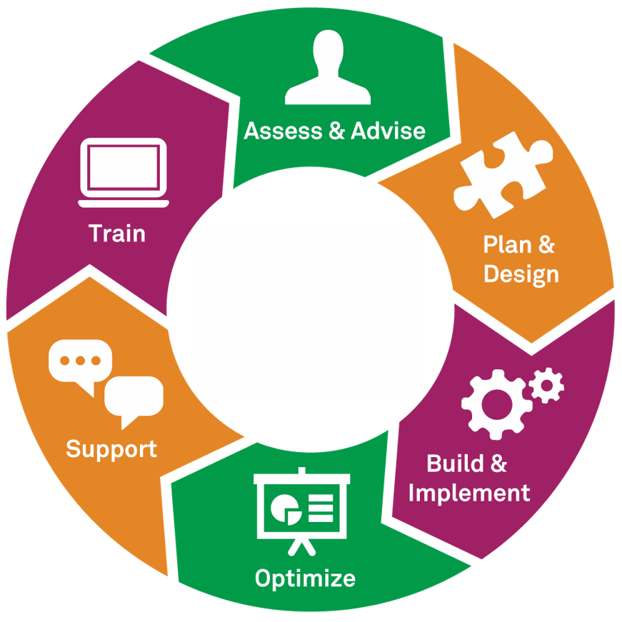
The Project Roadmap
Defining a Master Systems Integrator’s qualifications and responsibilities
Completing a pre-qualification process for a Master Systems Integrator
Requesting a Design-Assist for any system/equipment purchase, upgrade or replacement
Development of an Integration Roadmap
Create & provide an integration checklist to be issued to any vendor providing equipment or systems to ensure the technology is intelligent & open:
Type of Device
Demark Location
Open API
Communication Protocol
Device Location
Shop Drawings

Slide 8
Choosing an MSI
Partnering with a Master Systems Integrator provides benefits for projects of all sizes and scopes, but it becomes especially vital when dealing with projects that span entire portfolios. In these instances, a trusted partner is needed to provide, and deliver on, a roadmap to ensure portfolio growth is a straightforward process.
Master Systems Integrator Checklist | Average MSI | Above Average MSI | Hepta Systems
Identify all systems | x | X | X
Group systems into common and/or complementary functions | x | x | X
Identify which systems have no useful integration benefits | x | X | X
Identify client requirements (business, operational, etc.) | x | X | X
Integrate multiple brands and protocols | X | X | X
Develop Systems Integration strategic plan | X | X | X
Provide analysis, including function/benefit matrix and cost/benefit matrix |  | x | x
· Functional Specifications |  | X | X
· Quality Plan |  | X | X
· Design |  | x | X
· Implementation |  | X | X
· Integration |  | X | X
· Testing and Commissioning |  | X | X
· Operational Readiness Acceptance Testing |  | X | X
Legacy system unification independent of manufacturer support |  | x | x
Use the Systems Integration strategic plan, functional specifications, system design, and project quality plan for adherence and governance throughout project delivery |  |  | X
Provide custom built-in Building Analytics |  |  | X
Incorporate document retention |  |  | X
Platform available from single device with full read-write capability |  |  | X
In-house IT and software development departments |  |  | X
In-house software development departments |  |  | X
Execute 100% of the integration with no outside reliance from other sources |  |  | X

Slide 9
Jason Houck
Chief Information Officer
jc.houck@heptasystems.com
(810) 956-2600
www.heptasystems.com
(313) 263-4991

Slide 10
IN CLOUD
Reinforcement
Portfolio
Site
Machine
Signal
Pattern
Dashboards
Learning
Analytics
“First we shape our tools, thereafter they shape us”
Marshall McLuhan | Philosopher *
Embedded
Pattern
Enterprise
Signal
Edge
Enterprise
Analytics
Dashboard
Analytics
ON EDGE
* Be your own judge : http://bas.co/shape

Slide 11
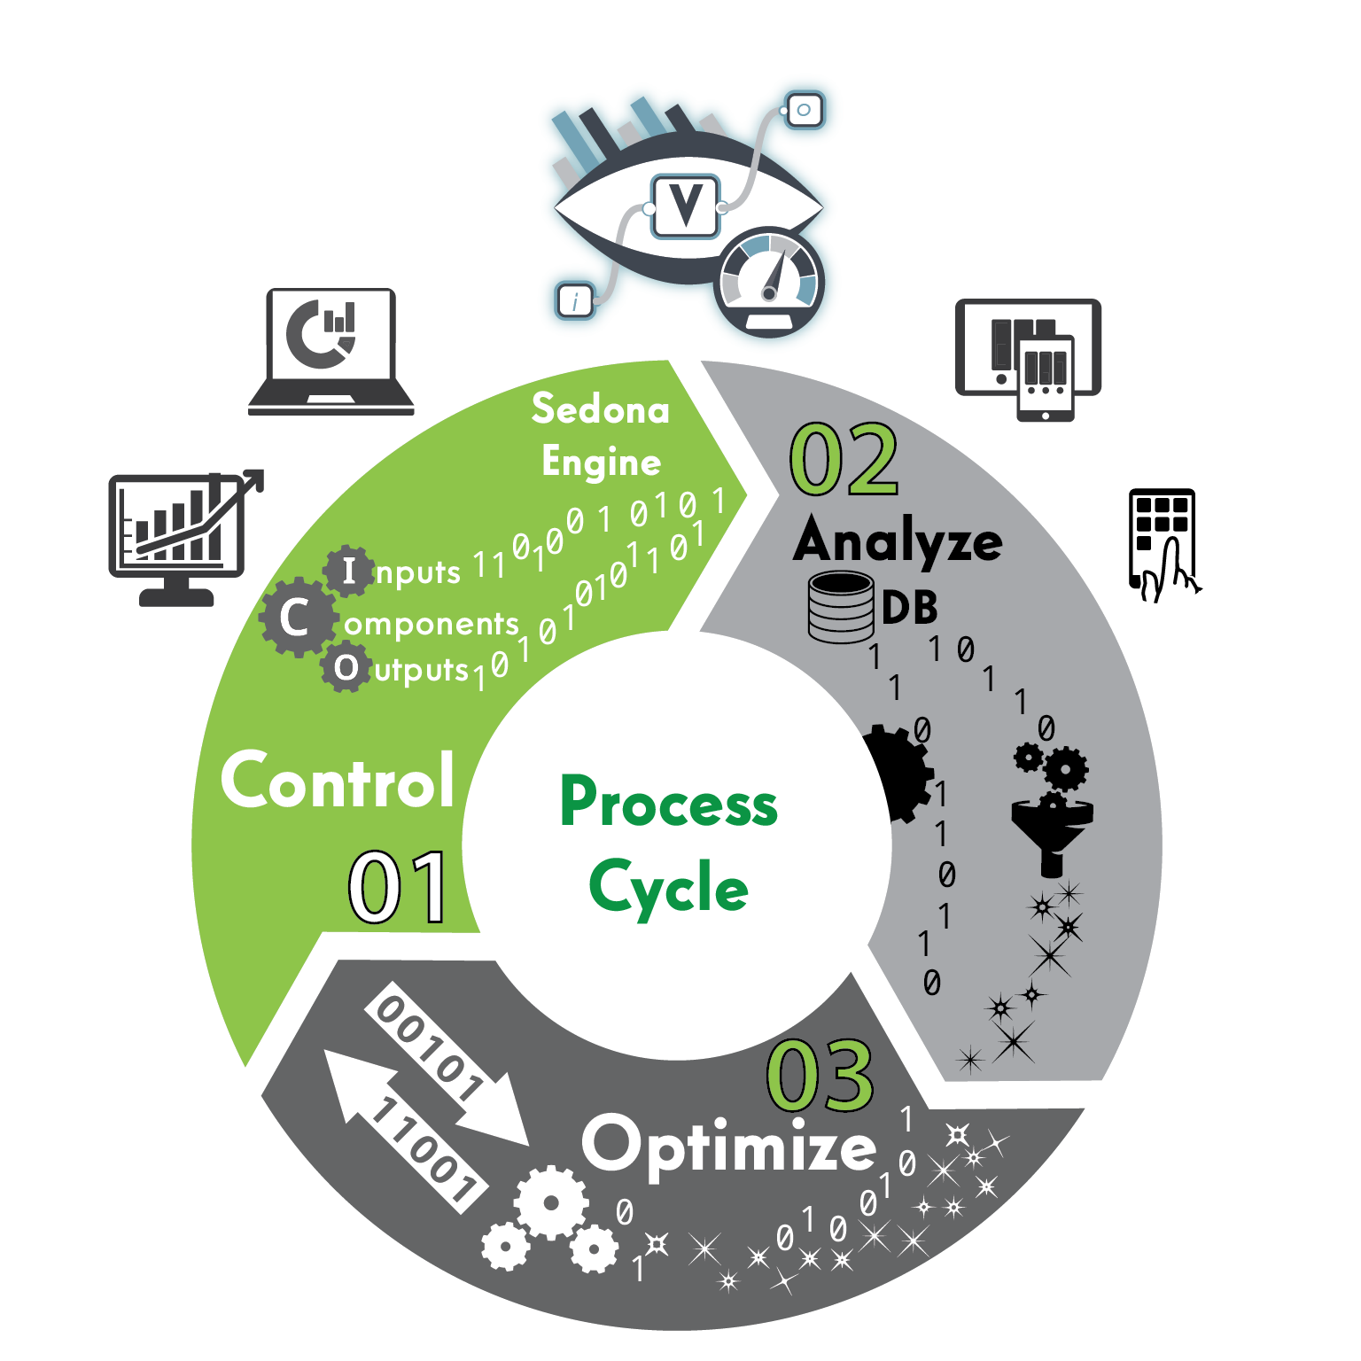
Roles in a Building’s Life Cycle are Reshaped by New Technology too, especially who will be the user of the latest control and analytics technologies.
Commissioning Agents
Energy Manager
Master System Integrator

Slide 12
System(s) Integration
Past & Now
Integrate – protocols
Trend
Alarm
Visualize - flat
Now & Future
Trend - Analyze – Optimize on Edge
Get data ready for cloud
Transmit to cloud securely, efficiently
Filter data on edge with signal processing
Get data ready for machine learning
Visualize – 4D
Notes:
Visualizations will be rendered HTML5

Slide 13

EDGE
Integrate
Trend
Analyze
Optimize
Visualize
Notes:
Integrate
Not only BMS data but BI / Customer data as well for KPI’s.
IE (Occupied #/KwH ) x (Occupied #/Gross Sales)
Trend
Filter with signal & calculus analysis
Analyze
Pattern Analytics
Optimize
Analysis to Real-time control engine loop
Visualize
Customize for customers needs within embedded dashboard

Slide 14
ENTERPRISE
Cloud AI
Amazon, Google
Reliability/Redundancy
Low Latency
Machine Learning Readiness
CPU cycle reduction on edge
Visualize
Internet
Enterprise Analytics
Load Balancer
Load Balancer
Load Balancer
EAC device
EAC device
EAC device
* EAC : Edge Analytics Controller
Notes:
Reliability/Redundancy | This is already in IT World. It is called Content Delivery Network |
Low Latency
Machine Learning Readiness | Tagged Normalized data by Project Haystack
CPU cycle reduction on edge
5. Visualization on edge is consistent with Enterprise. Automated with tagging. | Tickets look same whether printed at home or at the gate

Slide 15

CLOUD
Data
Normalized | Verified | Optimized
Analyze
Pattern | Signal | Prediction
Artificial Intelligence
Machine | Deep | Reinforcement > Learning
Notes:
Data
Normalized (By Haystack) | Verified (Signal processing on edge) | Optimized (Rollups)
Analyze
Pattern | Signal | Prediction
Machine Learning
Machine | Deep | Reinforcement

Slide 16
CONTACT US
ALPER ÜZMEZLER
alper@bassg.com
(954) 618-8070
ATX Office (512) 540-3010
Control, Analyze, Optimize
Continuously Commission
Apply Artificial Intelligence
EDGE
ENTERPRISE
CLOUD

Slide 17
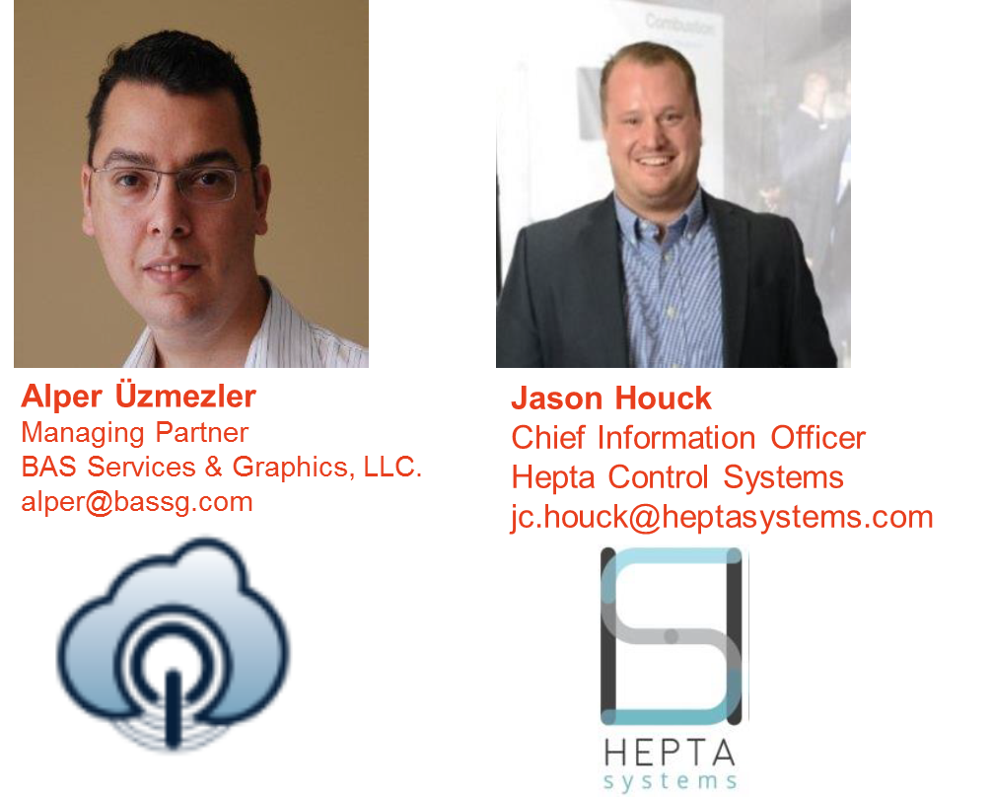
Q&A

Slide 18

Research Update Trevor Nightingale (National Research Council)
5.1 “Improving Organizational Productivity with Building Automation Systems” Update
http://www.caba.org/CABA/Research/NRC-Research-Project.aspx

Slide 19

Research Update Debra Becker (Honeywell)
5.2 “Intelligent Buildings and the Impact of the Internet of Things” Update
http://www.caba.org/CABA/Research/IB-IOT.aspx

Slide 20
Research Update Greg Walker (CABA)
5.3 New “Intelligent Building Design & Implementation”

Slide 21


Research Update Greg Walker (CABA)
5.4 Other CABA Research
“Connected Multi-Dwelling Units and the Internet of Things”
“Energy Roadmap for the Connected Home”

Slide 22
White Paper Sub-Committee Update Ken Wacks (Ken Wacks Associates)
6.1 “EMerge Alliance Hybrid AC/DC – Part 2”
EMerge Alliance

Slide 23
6.2 “Smart Cities” Ken Wacks (Ken Wacks Associates)
Electro-Federation Canada
Canadian Automated Vehicles Centre of Excellence (CAVCOE)
ABB
AHAM (Association of Home Appliance Manufacturers)
Bristol City Council
Canadian Advanced Technology Alliance (CATA)
Canadian Chamber of Commerce
Canadian Electricity Association
Canadian Open Data Exchange (ODX)
Canadian Urban Institute
Canadian Water Quality Association
City of Atlanta
City of Edmonton
City of Toronto
City of Vaughan
Consultant (Former Manitoba Hydro)
Consumer Technology Association (CTA)
CSA Group
Etron Energy Corp.
Information Technology Association of Canada
JLL
National Research Council of Canada
Navigant Research
Ontario Ministry of Research and Innovation
Retail Council of Canada
Robert H. Lane and Associates Inc.
Smart Cities Council
Smart Cities Management Consultant
Sustainable Resources Management Inc.
Unmanned Systems Canada
Wavefront

Slide 24
White Paper Sub-Committee Update Ken Wacks (Ken Wacks Associates)
6.3 "Intelligent Building Advances in the Quick Service Restaurant Industry“
Schneider Electric
Arrow Electronics
AT&T
Carpigiani Group
Small Box Energy

Slide 25
White Paper Sub-Committee Update Ken Wacks (Ken Wacks Associates)
6.4 “The Intelligent Thermostat for Multifamily Apartment Buildings"
WorkTechWork.com
Forest City Reality Trust

Slide 26
White Paper Sub-Committee Update Ken Wacks (Ken Wacks Associates)
6.5 “Elevator Technologies in High Rise Intelligent Buildings”
Asian Institute of Intelligent Buildings
Architectural Elevator Consulting

Slide 27
6.6 “Academic Training for the Connected Home and Intelligent Buildings Industries” Ken Wacks (Ken Wacks Associates)
Texas A&M University
Algonquin College
Automation Federation
Bedrock Learning, Inc.
British Columbia Institute of Technology
CEES-Advisors
College of DuPage
ESPA (The Electronic Systems Professional Alliance)
ETA International
George Brown College
Heartland Community College
Irvine Valley College
Lambton College
Laney College - BEST Center
LonMark International
QUEST
Rio Hondo Community College District
Robert H. Lane and Associates Inc.
Seneca College
Siemens Industry, Inc.
Sustainable Resources Management
Wharton County Junior College
All previously completed IBC White Papers can be downloaded at: www.caba.org/IBC

Slide 28
New Business Ron Zimmer (CABA)
7.1 CABA 25 Industry Benefits and CABA Video
http://caba.org/CABA/Membership/Membership_Benefits/CABA/About/Member_Benefits.aspx?hkey=d50fc042-1d2a-4727-9fca-e7d4aa1e0a33
7.2 Other new CHC business

Slide 29
Announcements Ron Zimmer (CABA) Debra Becker (Honeywell)
8.1 Past Event Overview:
AHR EXPO HVACR Trade Show, Jan 30 – Feb 1, 2017, Las Vegas, NV
DistribuTECH Jan 31- Feb 2, 2017, San Diego, CA
8.2 Upcoming Event:
CABA Intelligent Buildings & Digital Home Forum, April 26 - 28, 2017, Santa Clara, CA
8.3 Next IBC Meeting (April 2017)
IBC Meeting (Town Hall), April 27, Santa Clara, CA

Slide 30


Adjournment Debra Becker (Honeywell)
Continental Automated Buildings Association (CABA) 613.686.1814 Toll free: 888.798.CABA (2222)
caba@caba.org www.CABA.org
www.caba.org/IBC
Connect to what’s next™

